Slide 1
Mentorness Internship Programme
Batch – MIP-DA-09 - June2024
Task -2
Corona Virus Analysis with SQL - Submission Deadline: Day 17 (12/06/2024): Analyze COVID-19 data using SQL and data analysis skills. Gain insights into the pandemic's impact through dataset examination. Tasks include answering questions provided in the "Reference File for Corona data" using SQL queries. Explore real-world data scenarios and seek guidance as needed.
Submitted By – Prajjwal Maurya

Slide 2
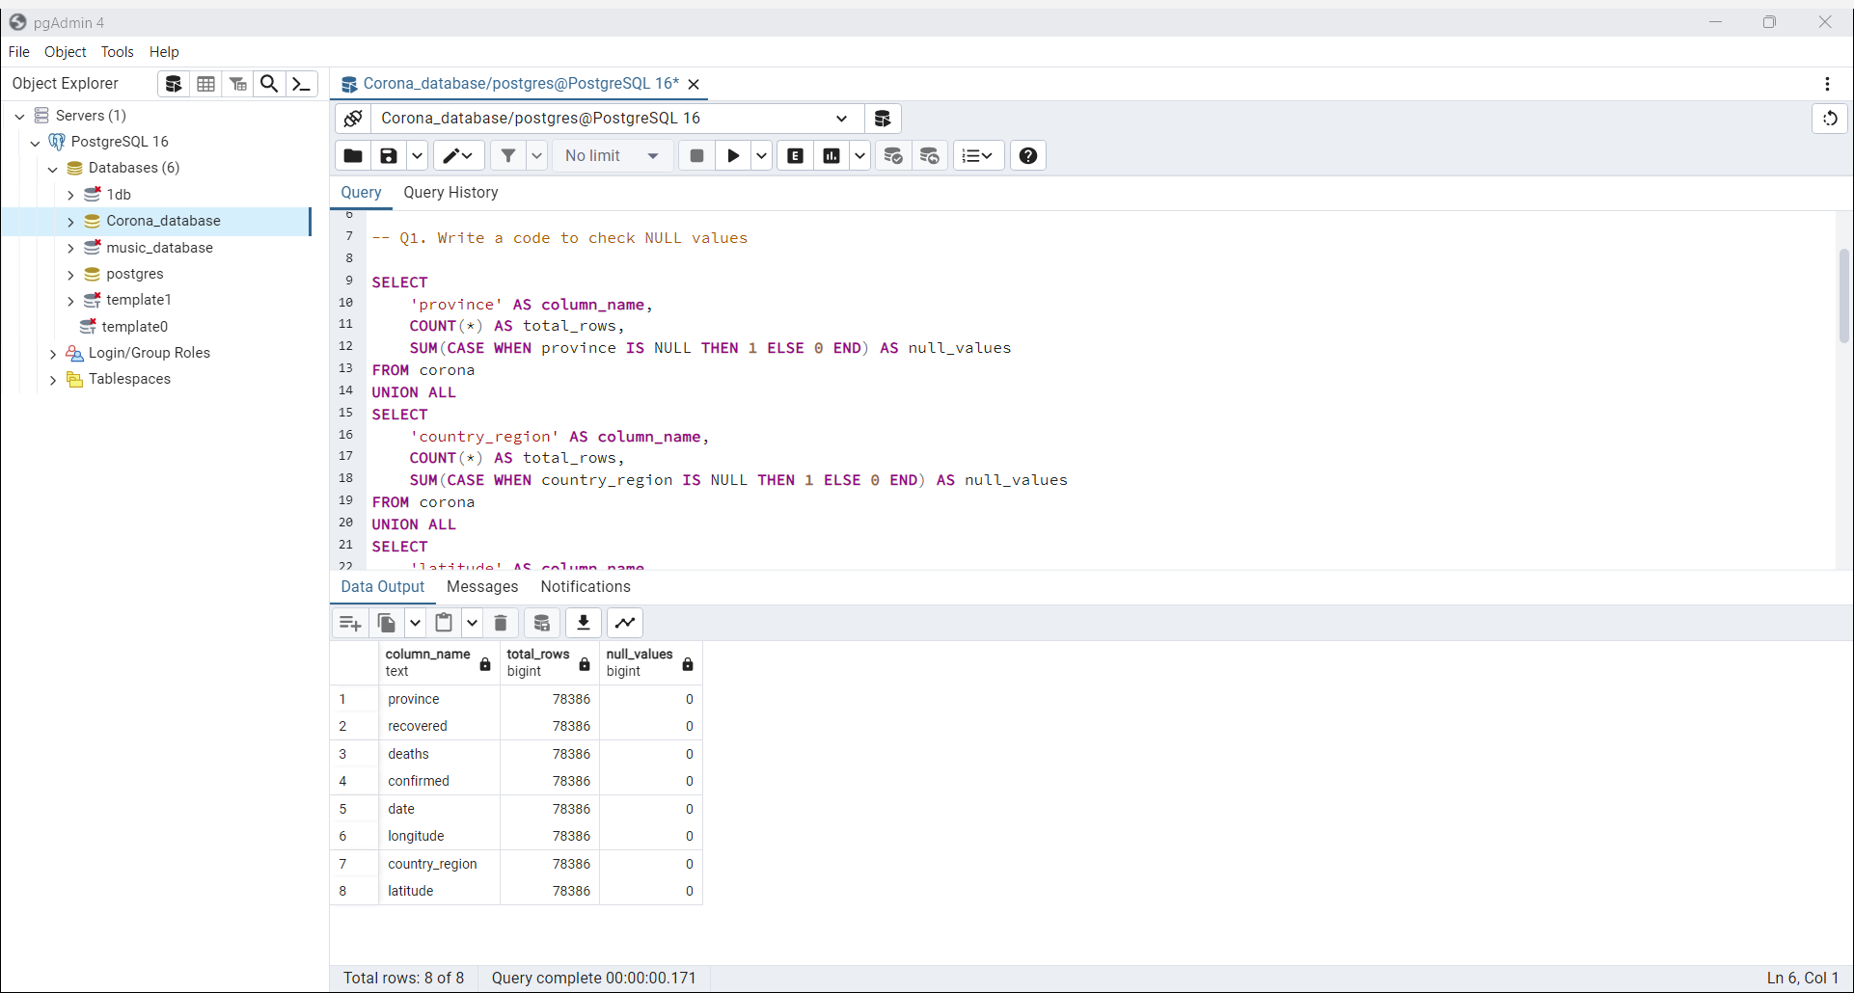

Slide 3
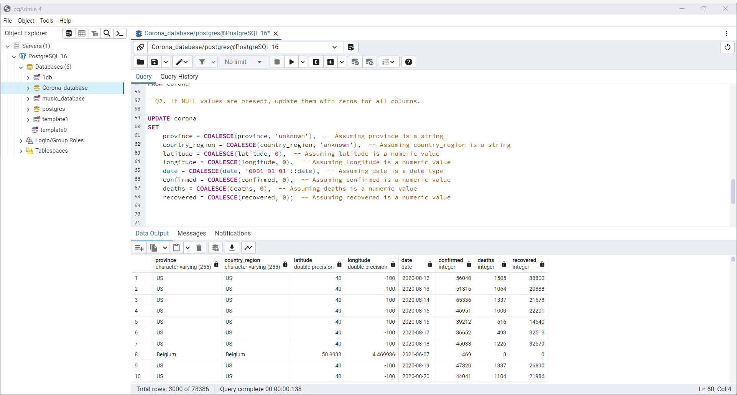

Slide 4
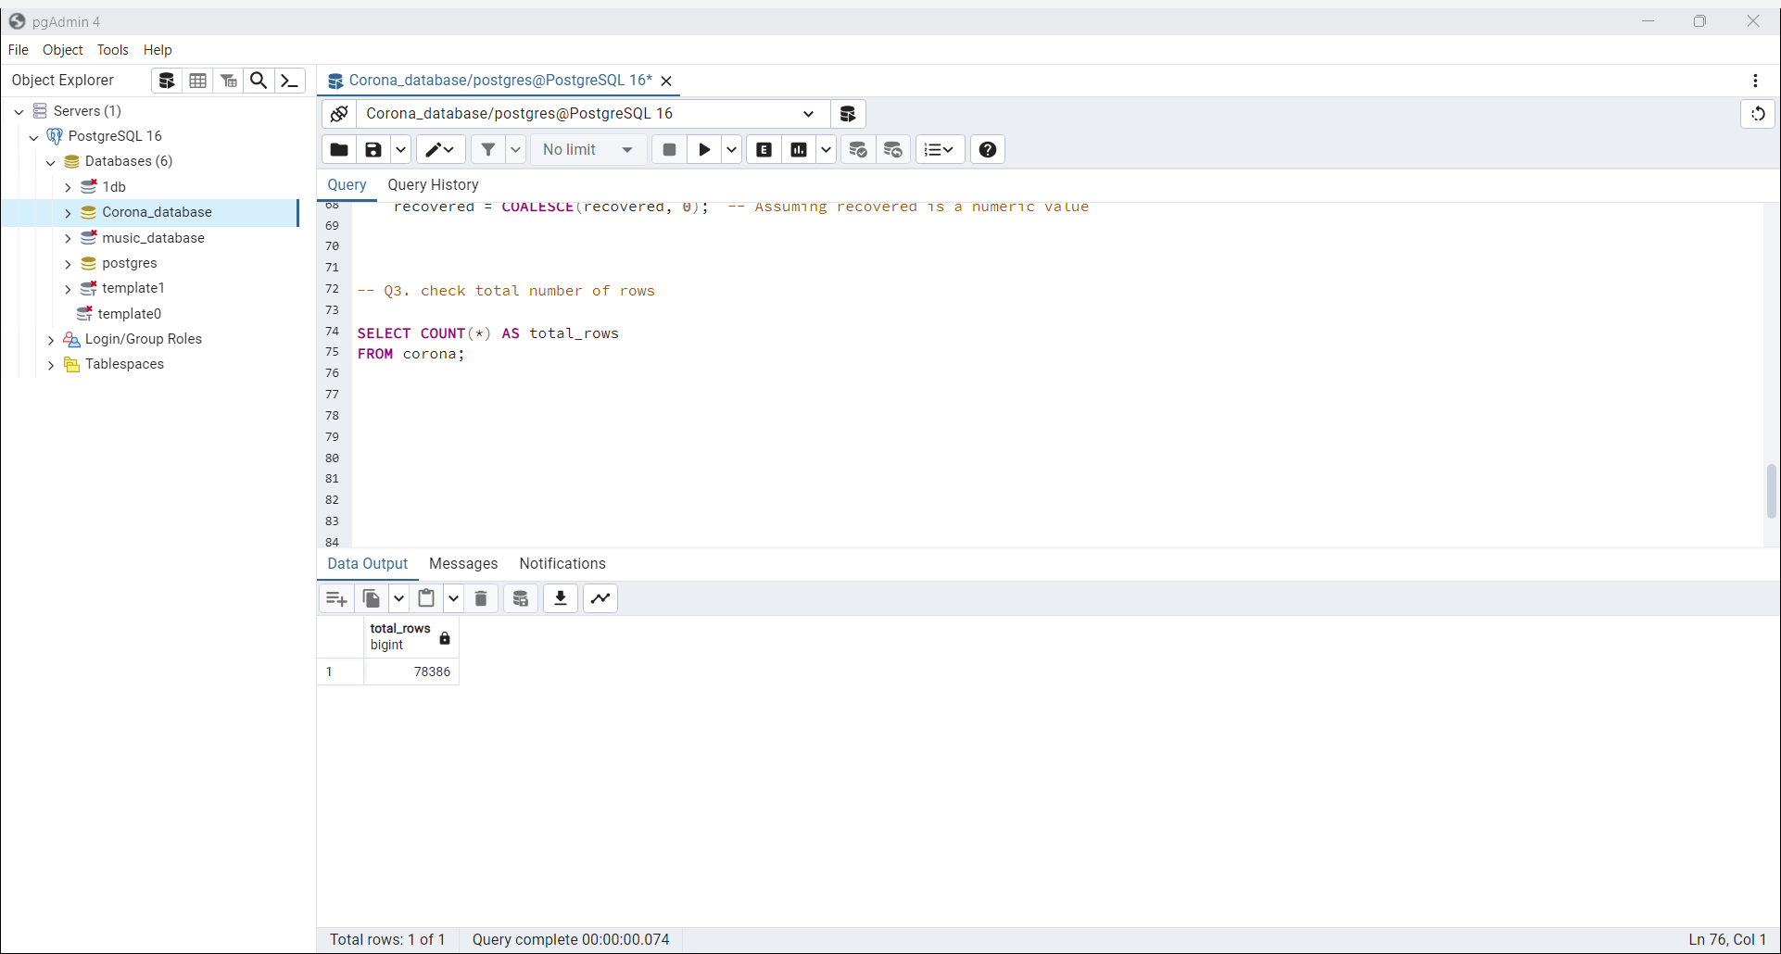

Slide 5
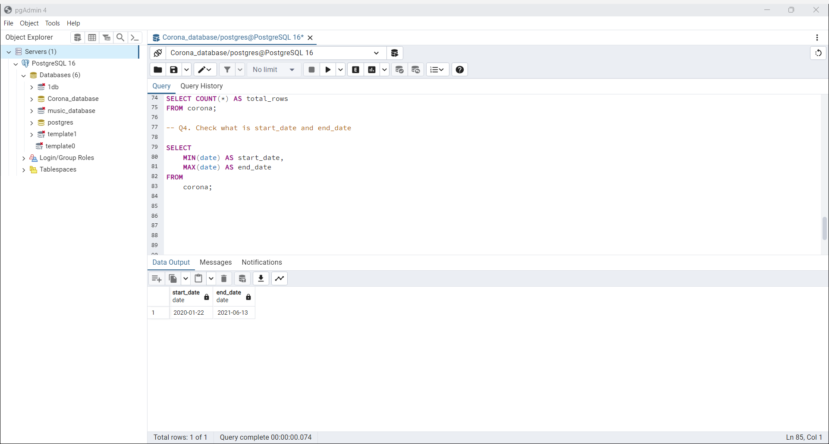

Slide 6
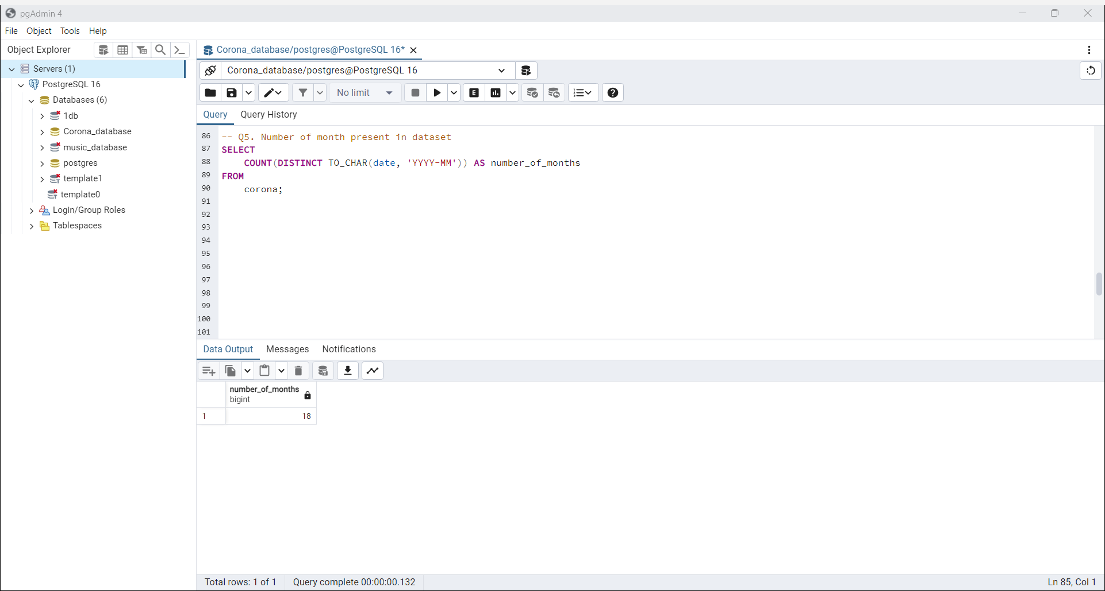

Slide 7
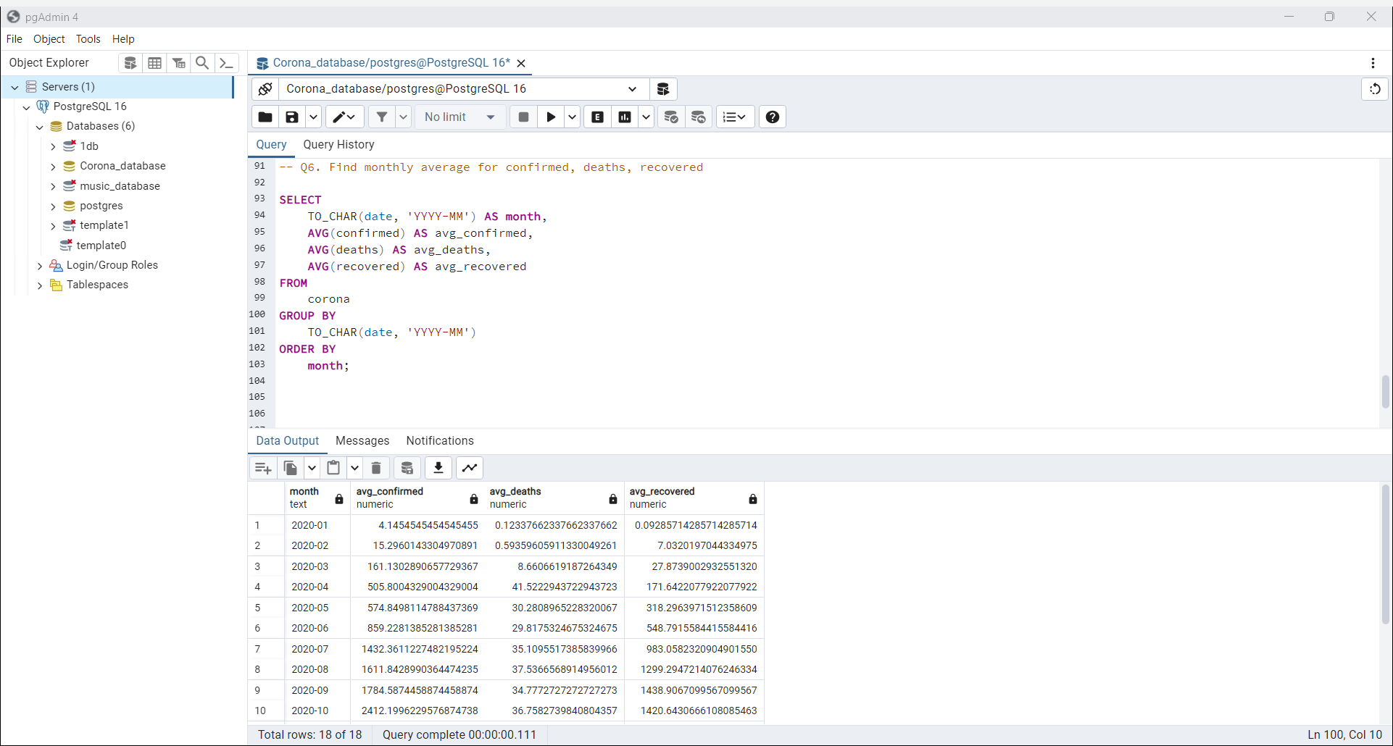

Slide 8
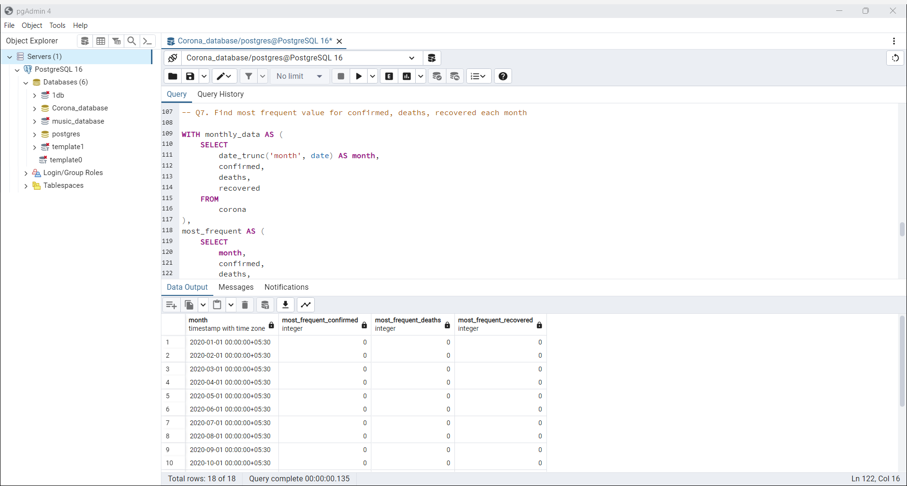

Slide 9
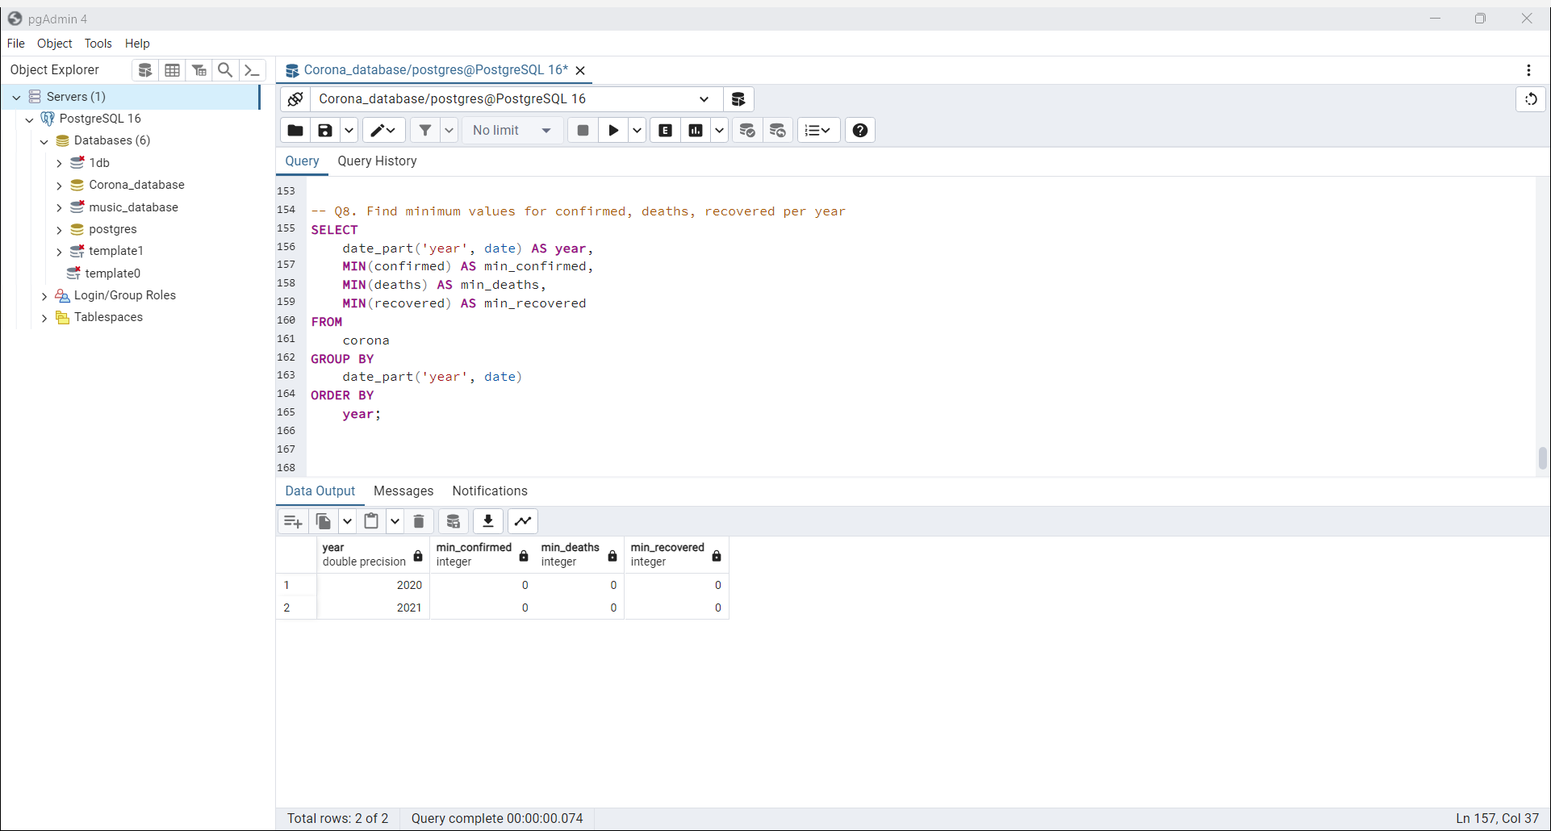

Slide 10
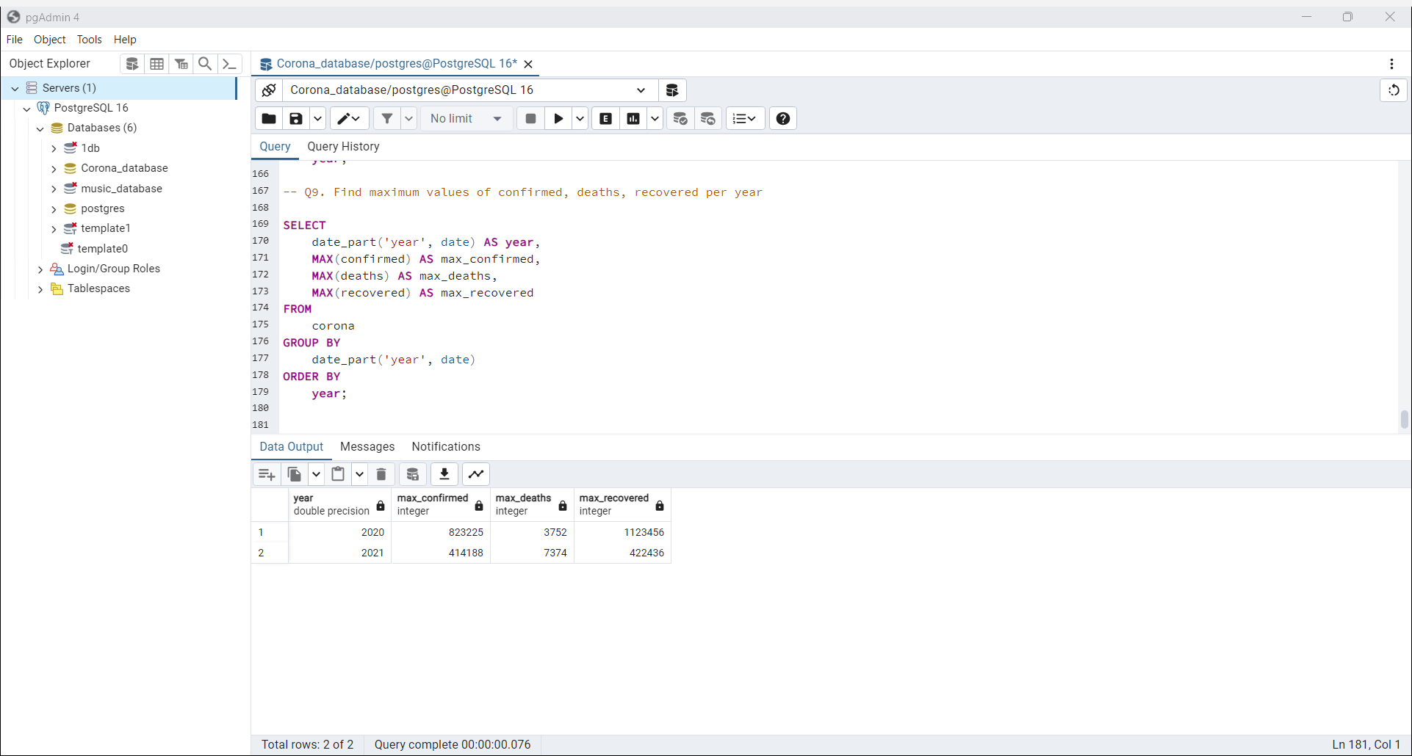

Slide 11
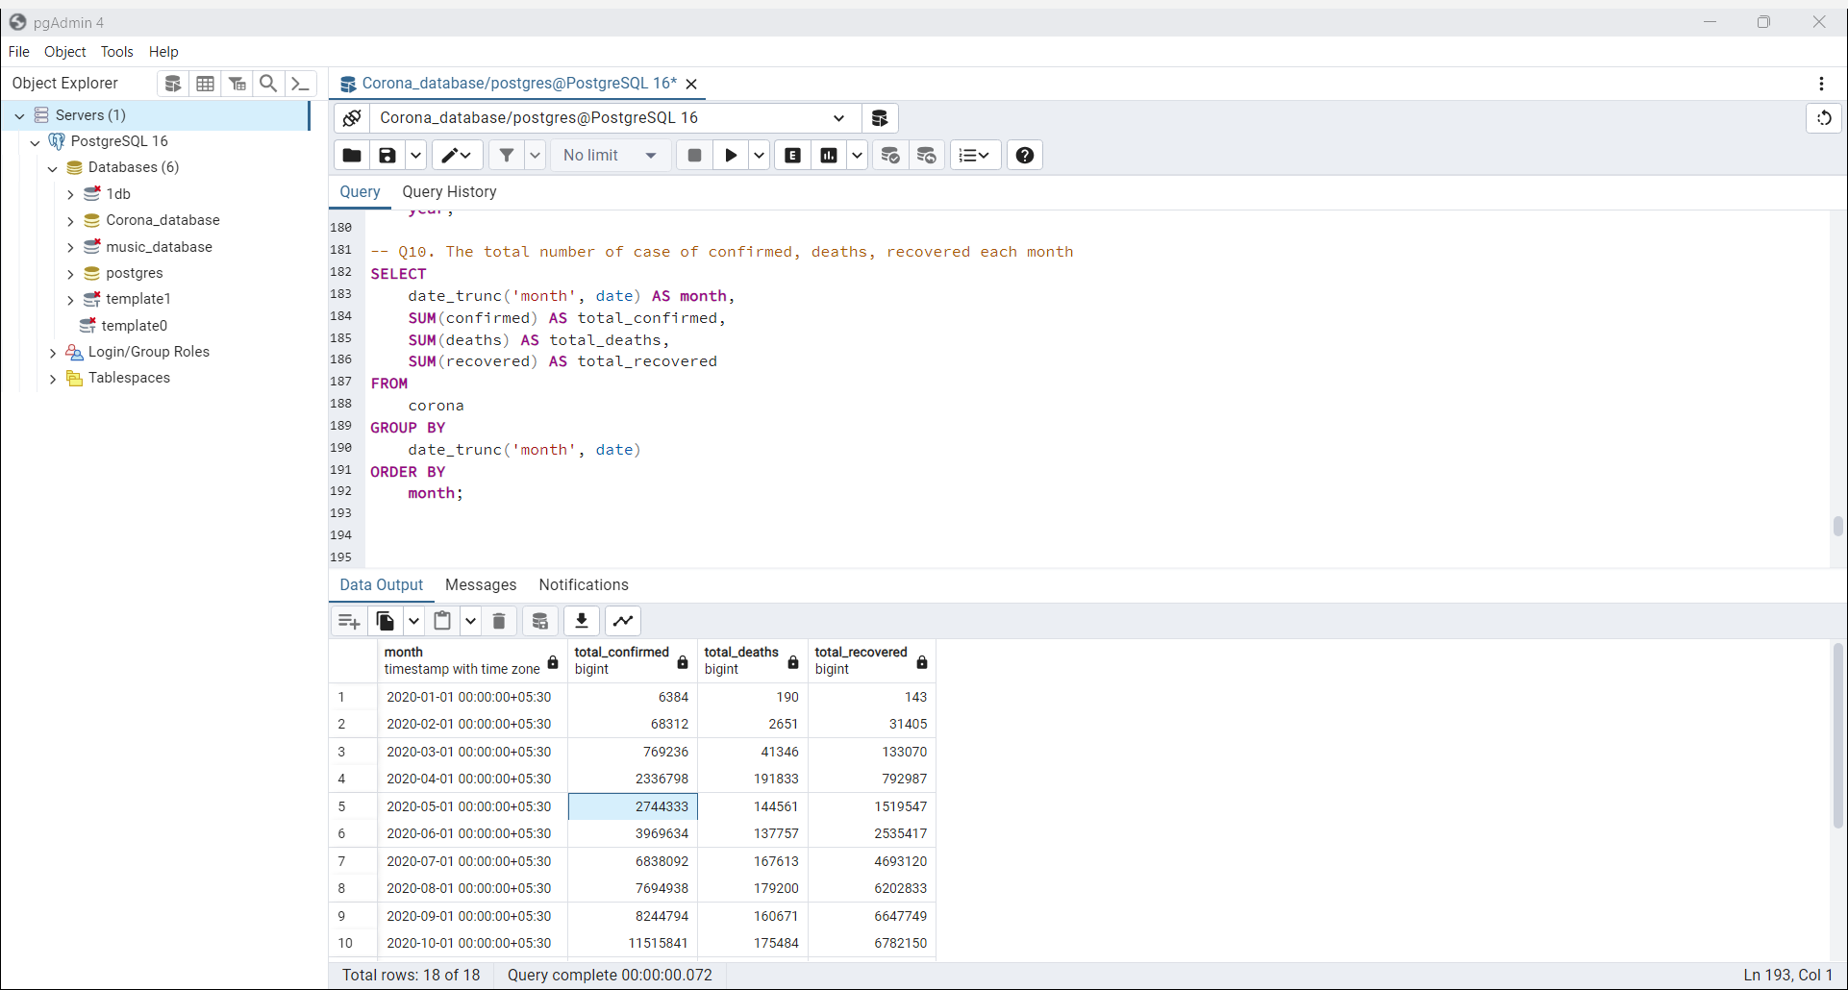

Slide 12
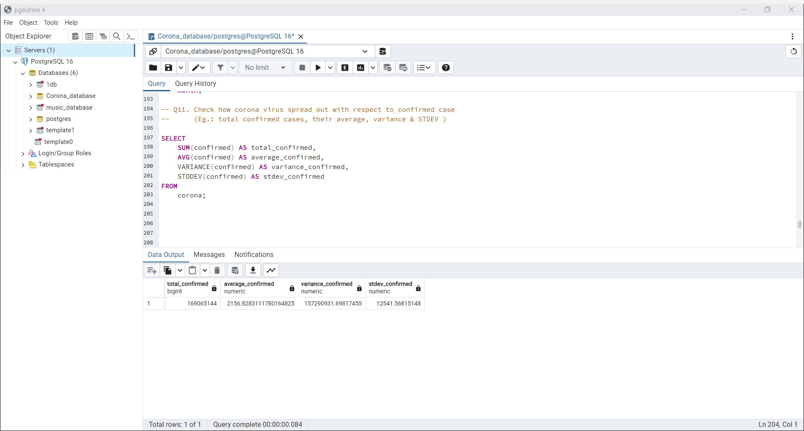

Slide 13
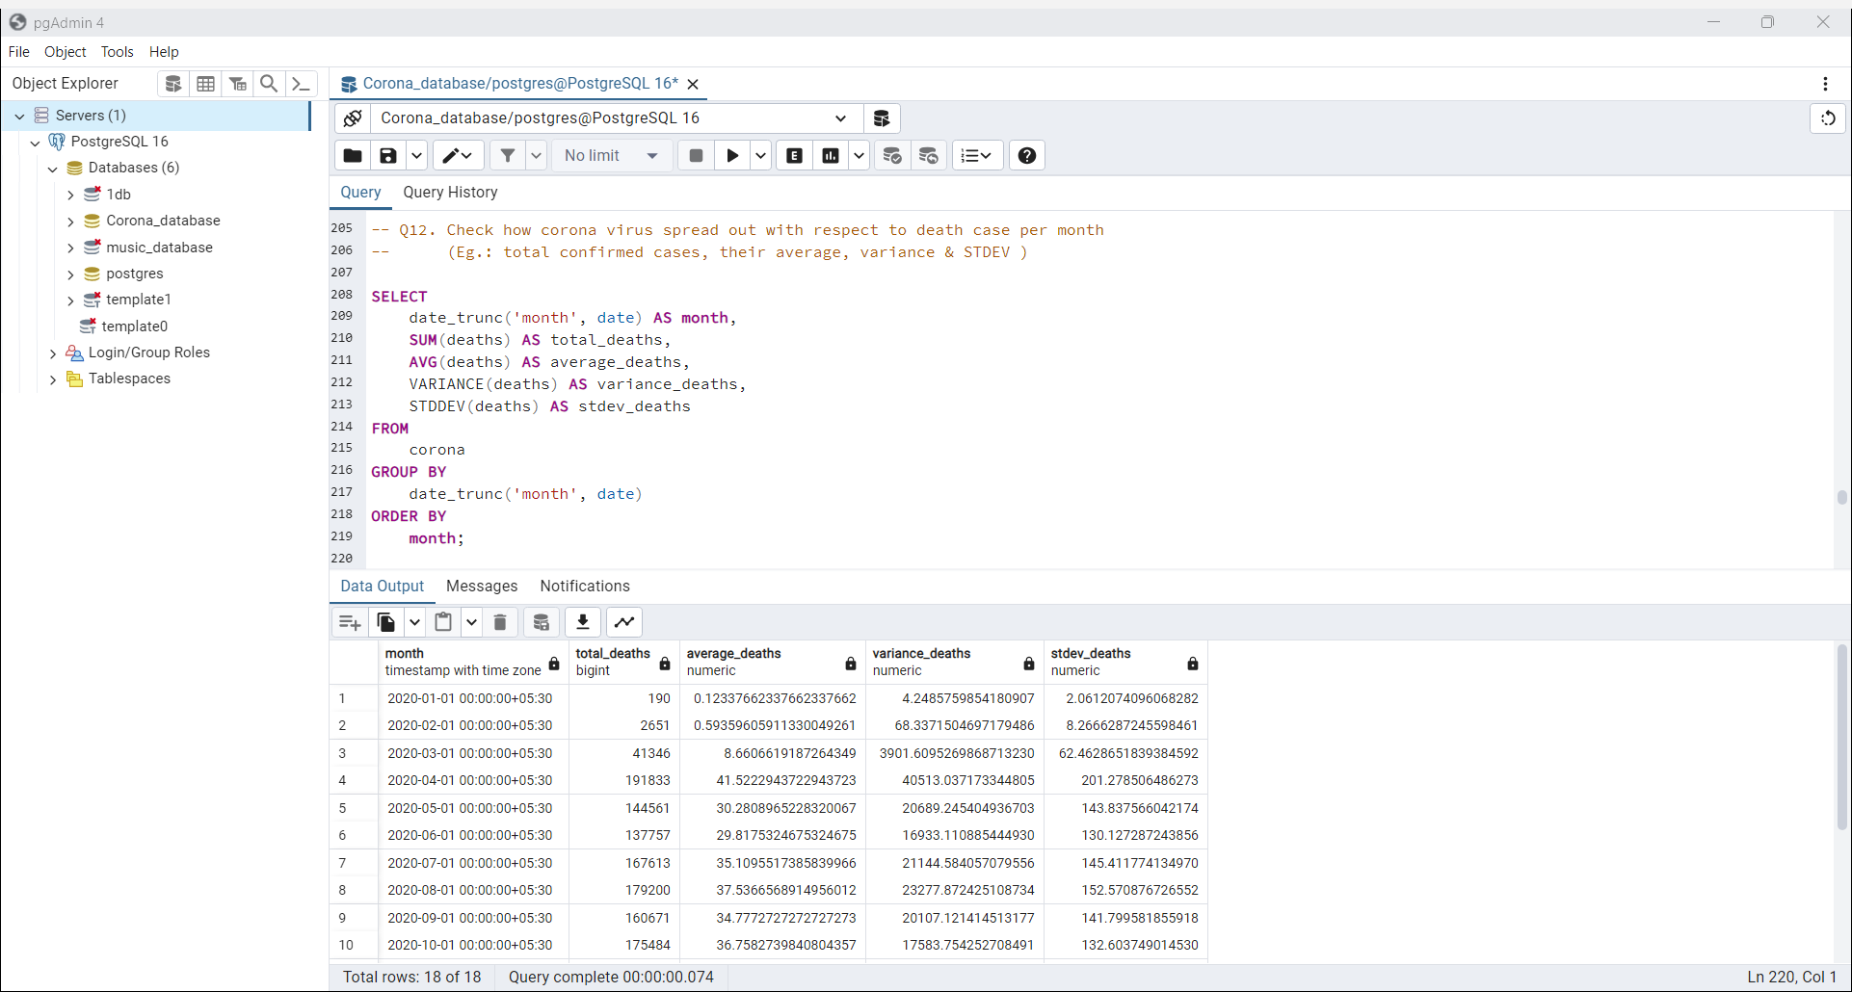

Slide 14
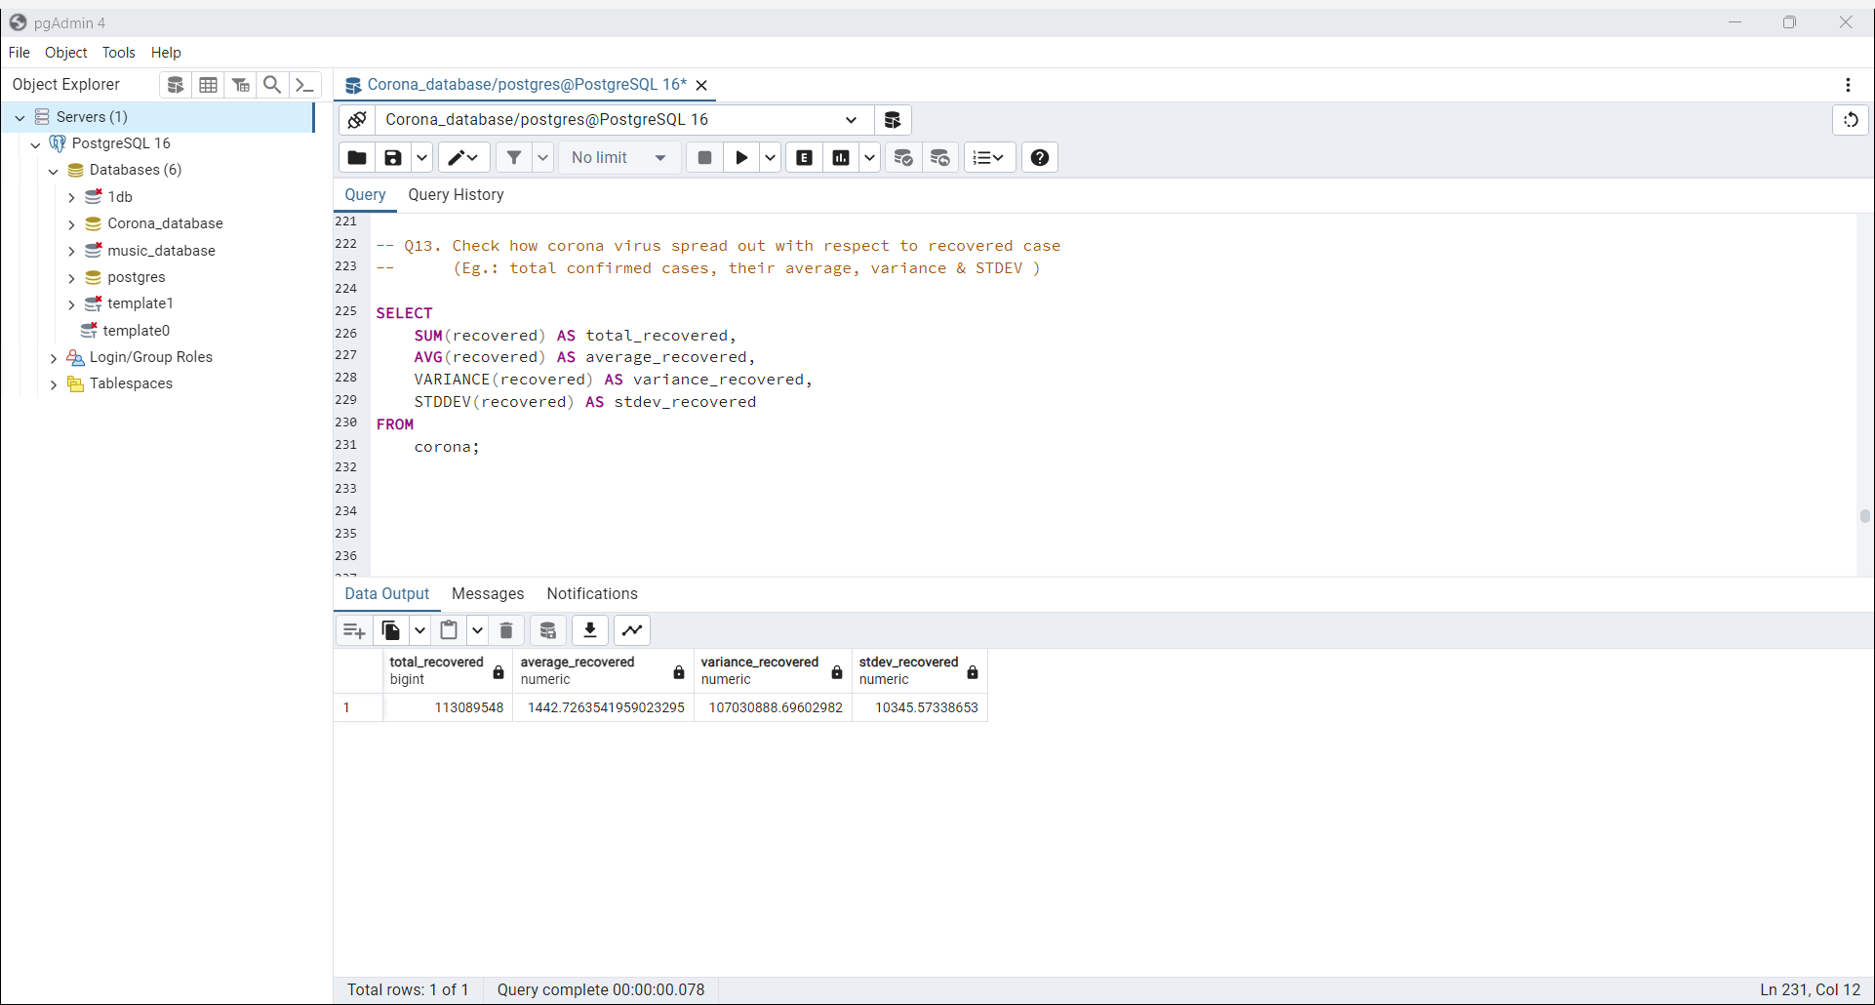

Slide 15
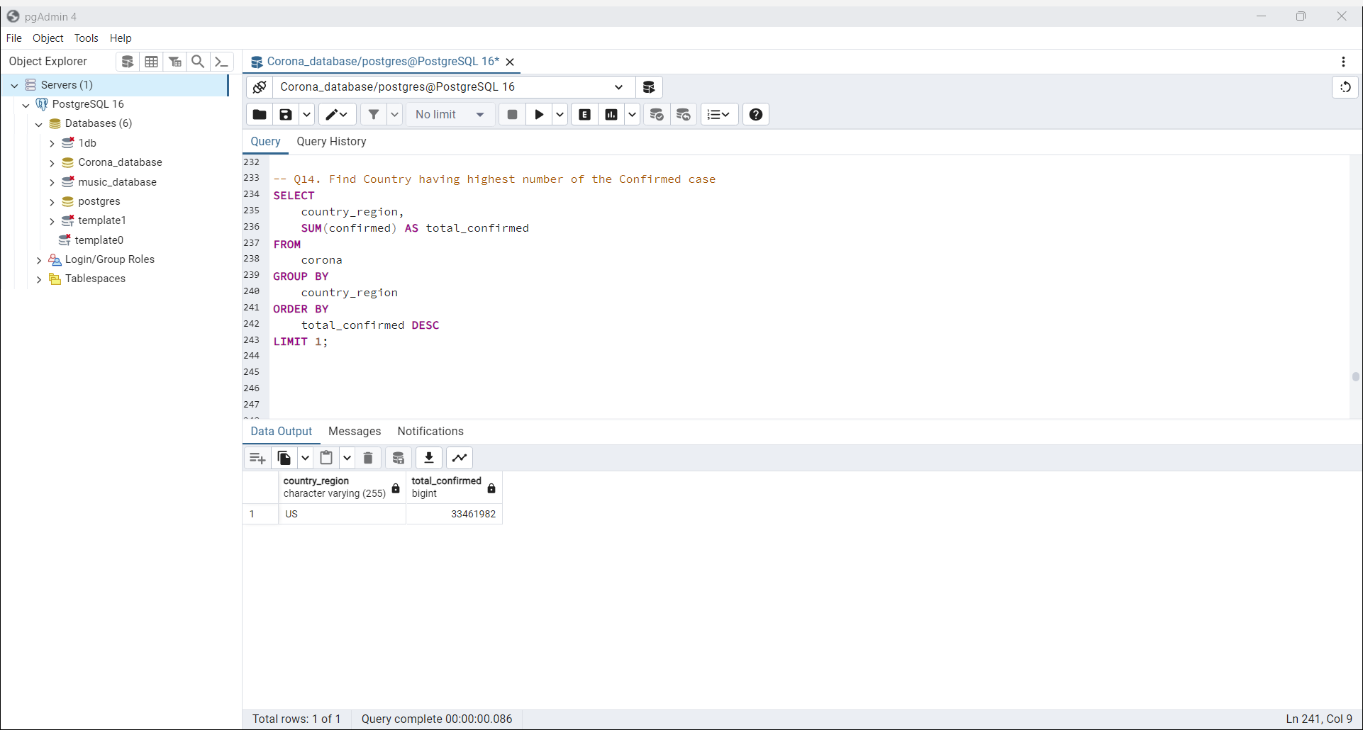

Slide 16
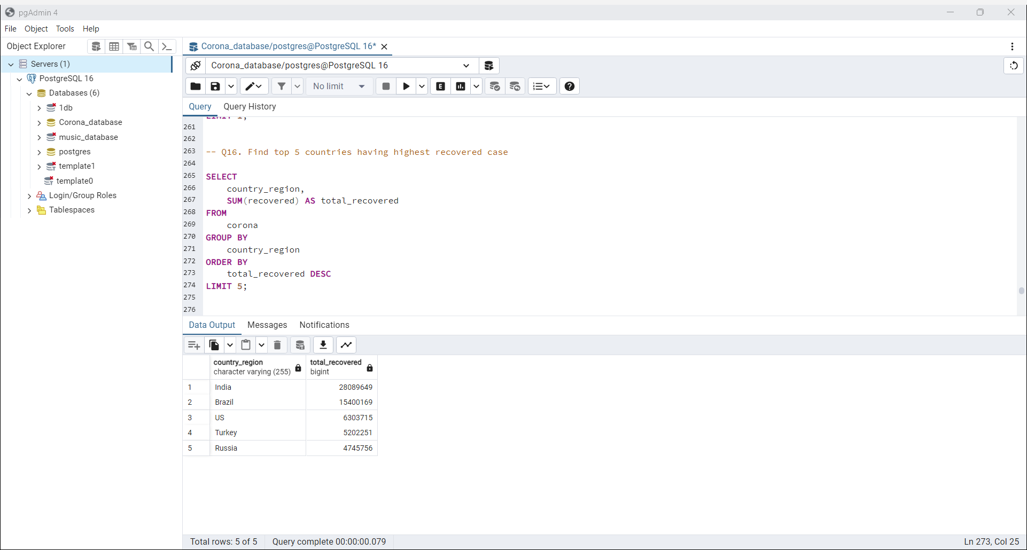

Slide 17


